Slide 1
PREVENTS Time Series Plotting
(ROUGH) Results of plotting experimental PREVENTS data

Slide 2
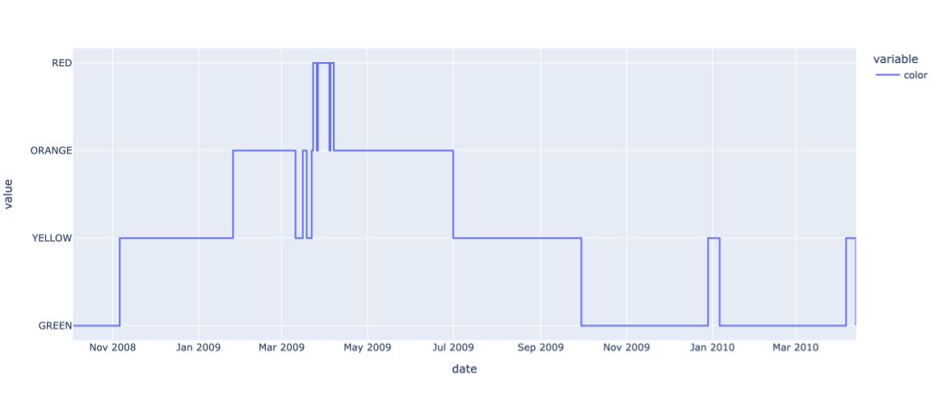

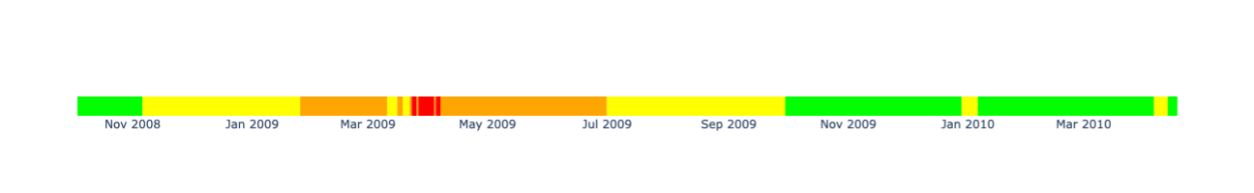
Color Code

Slide 3
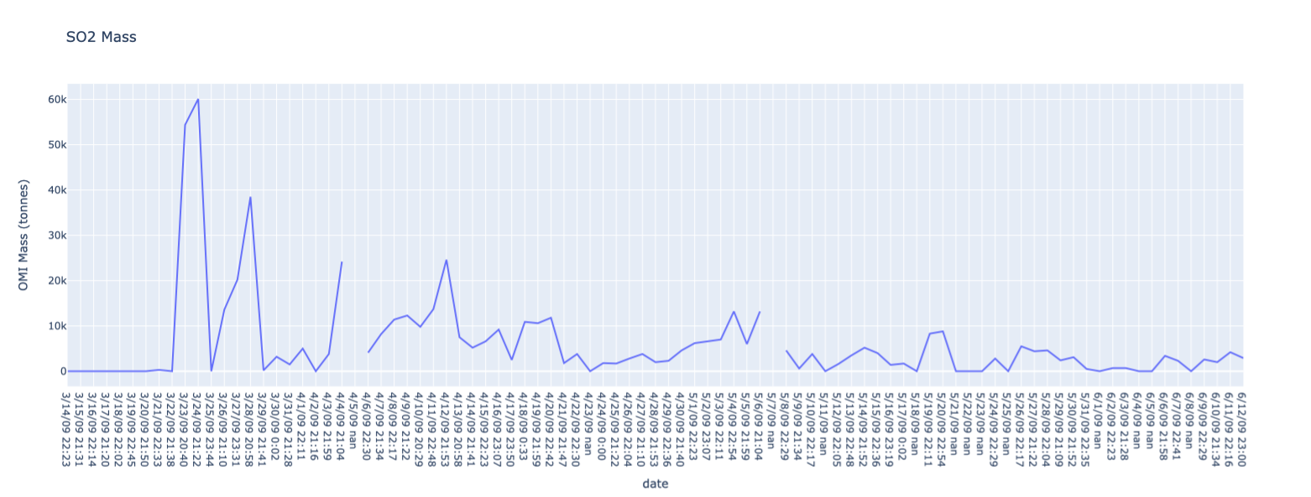
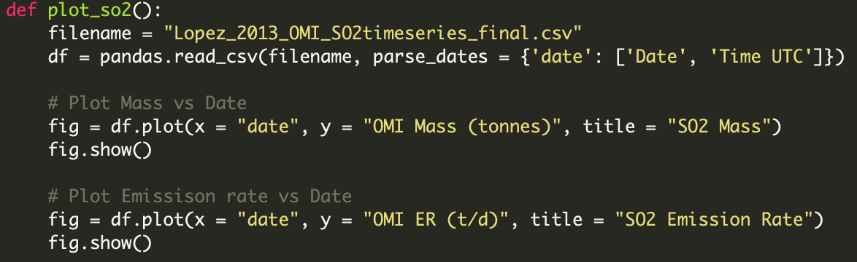
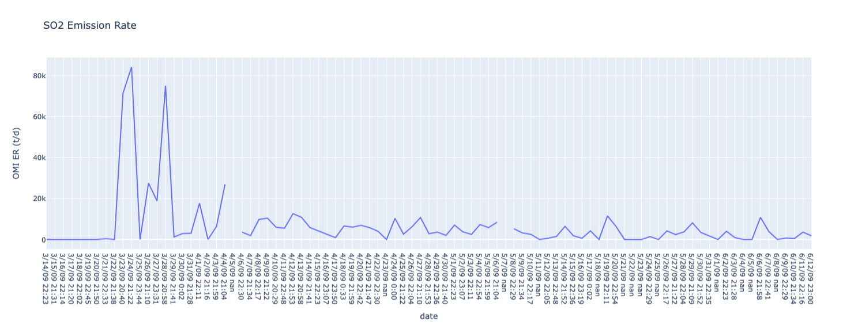
SO₂ Data

Slide 4
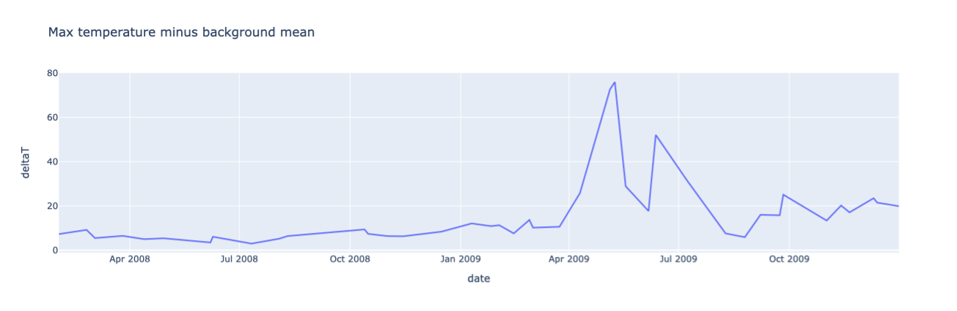
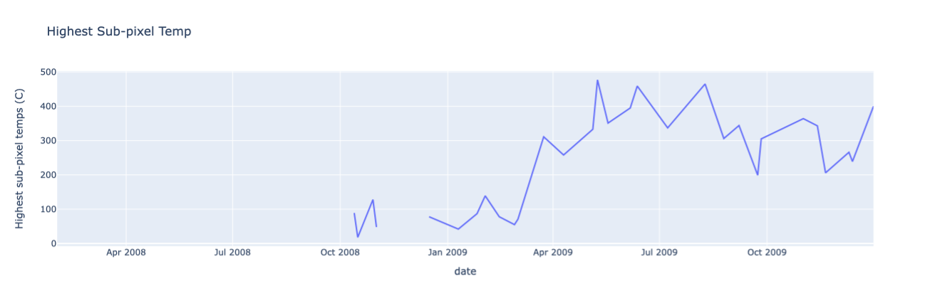
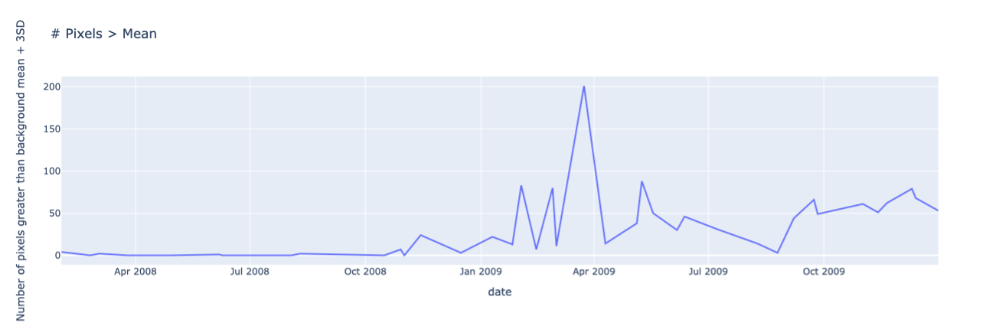
Aster (Thermal) Data

Slide 5
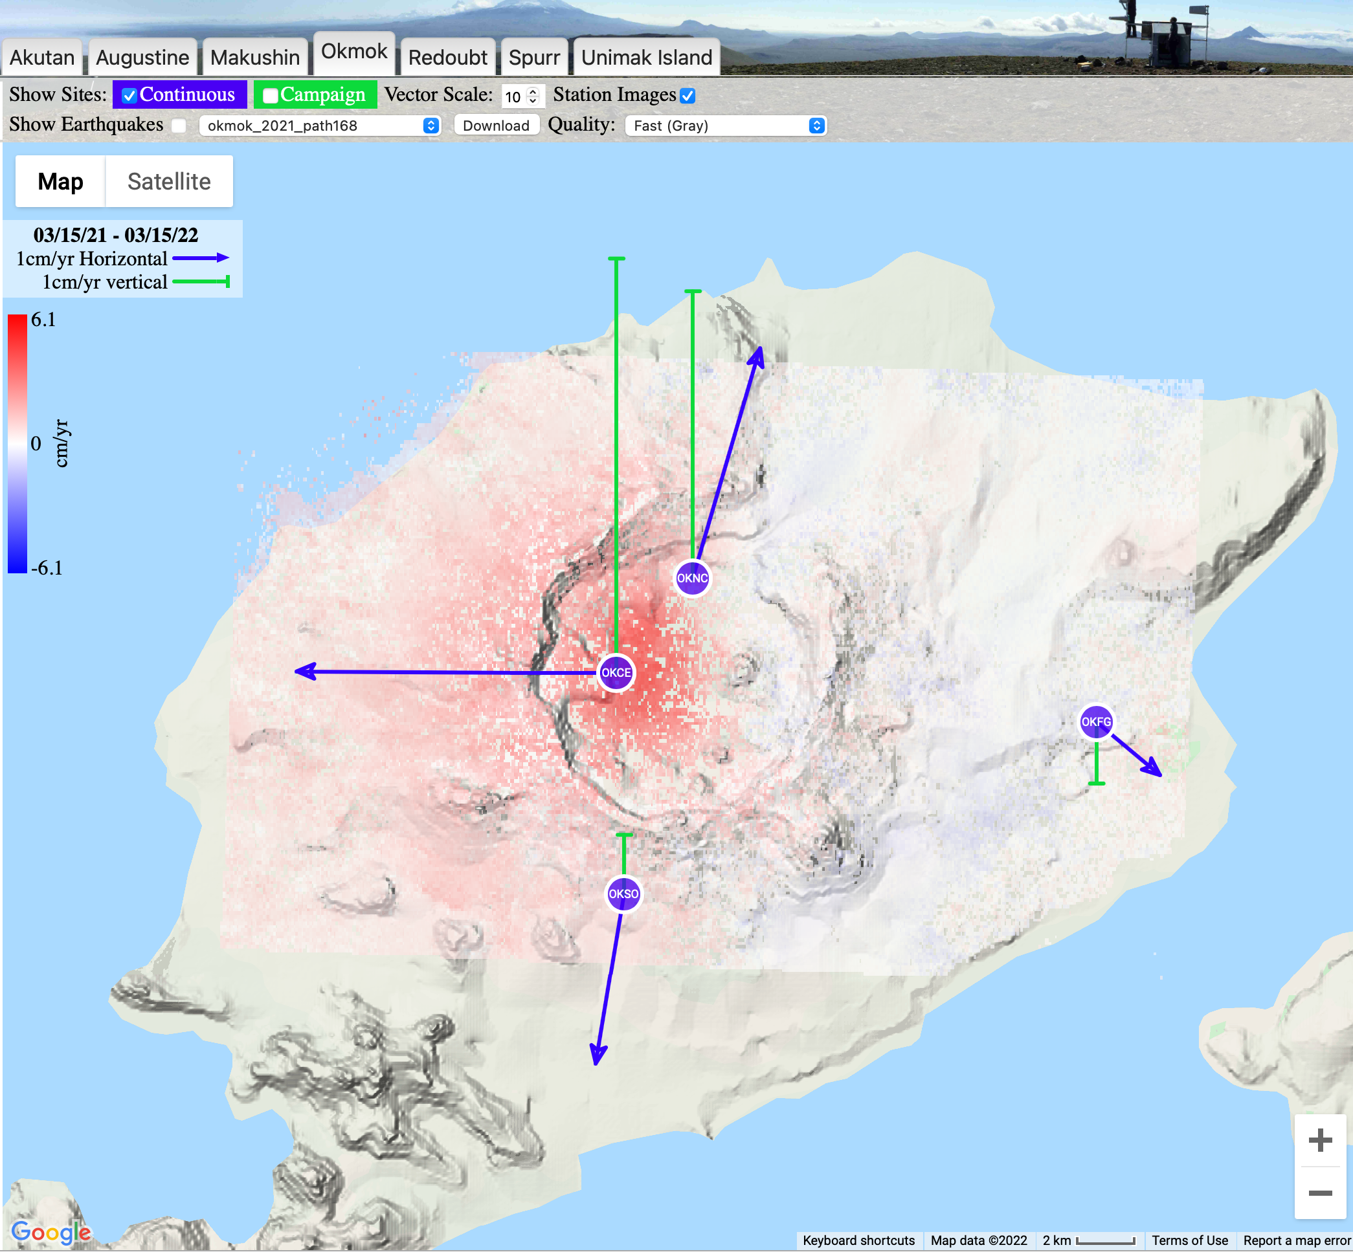
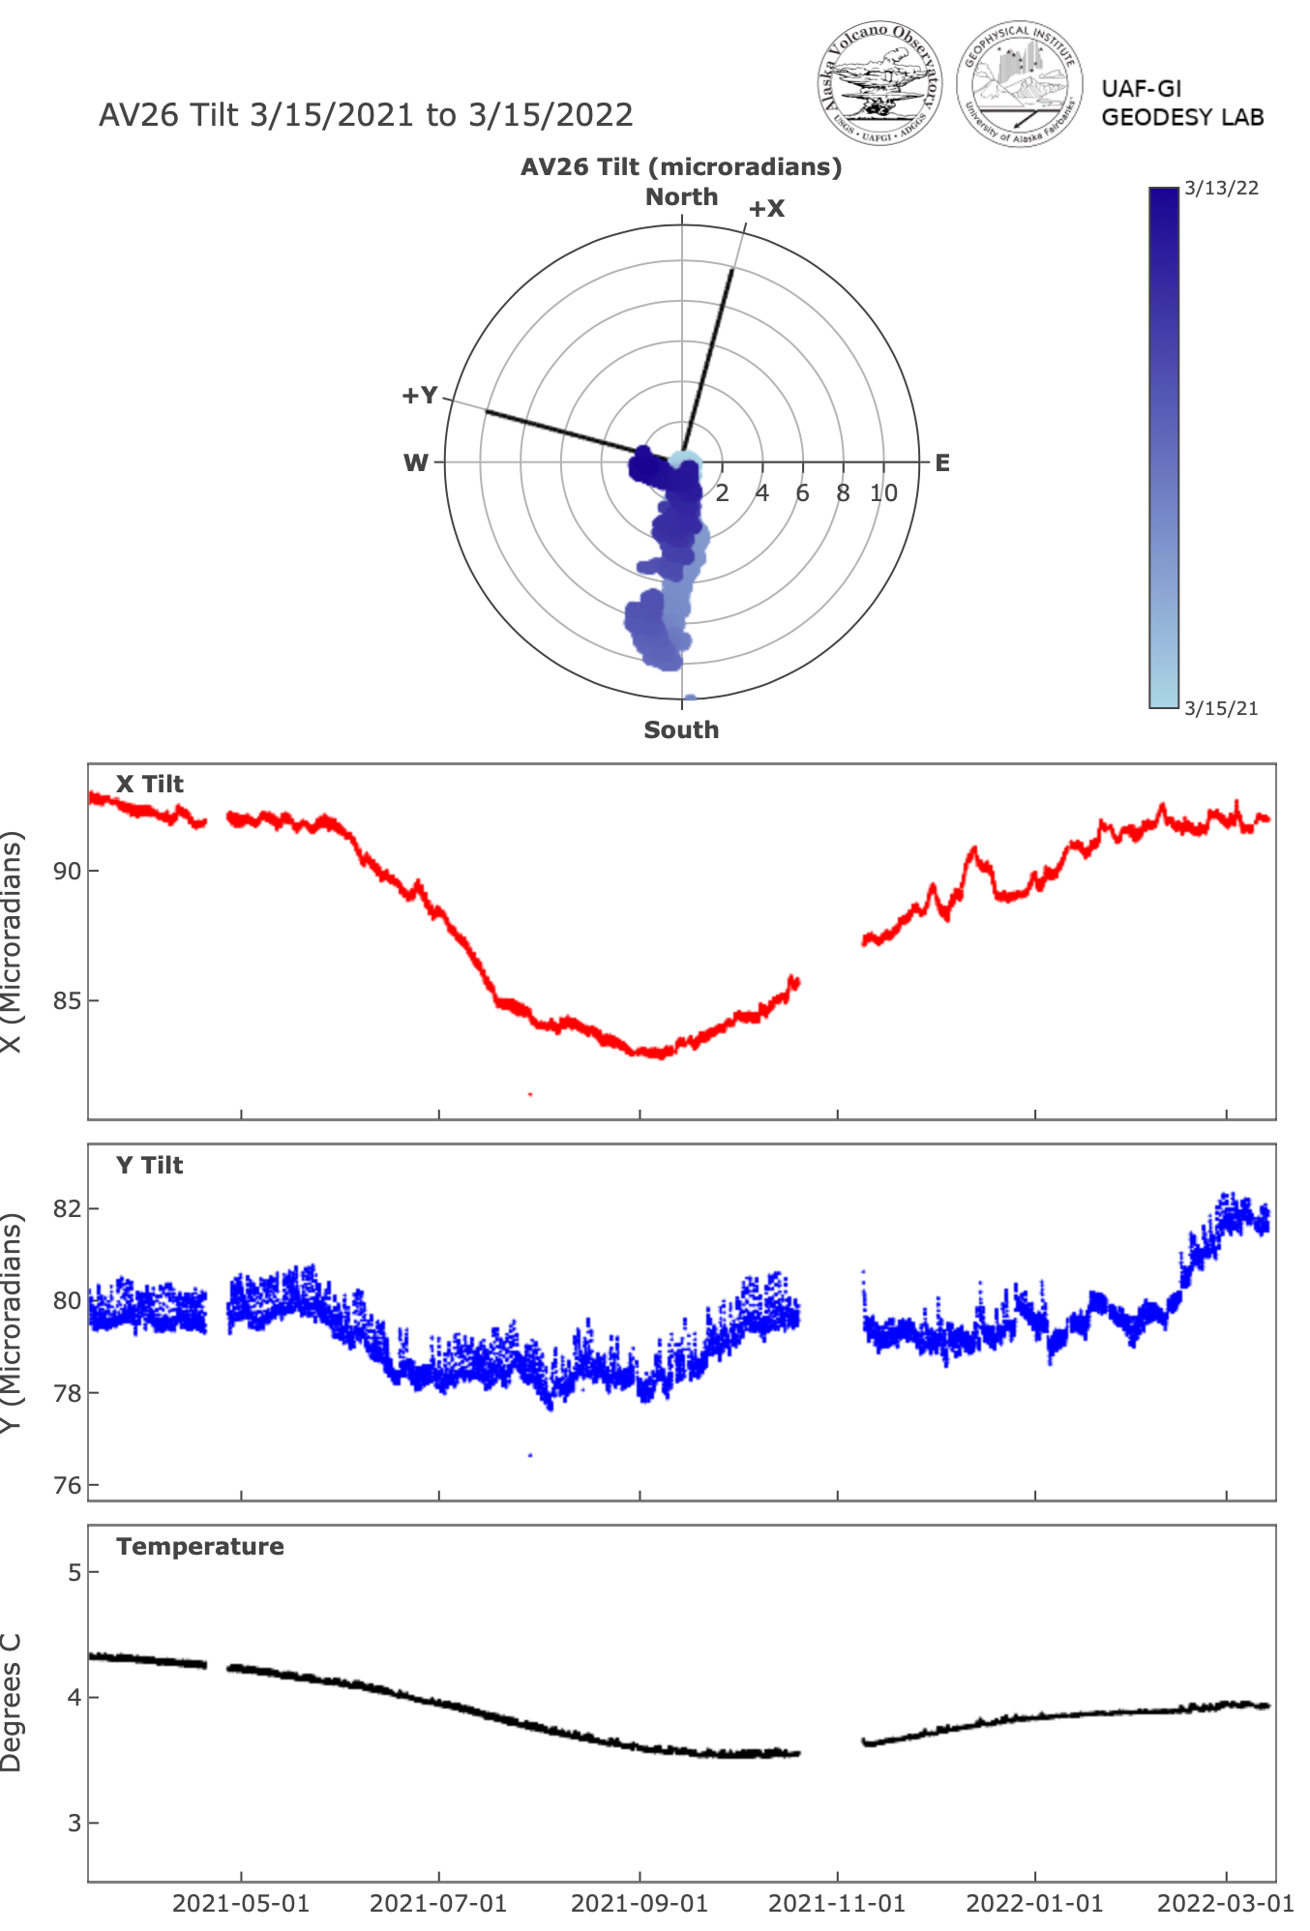
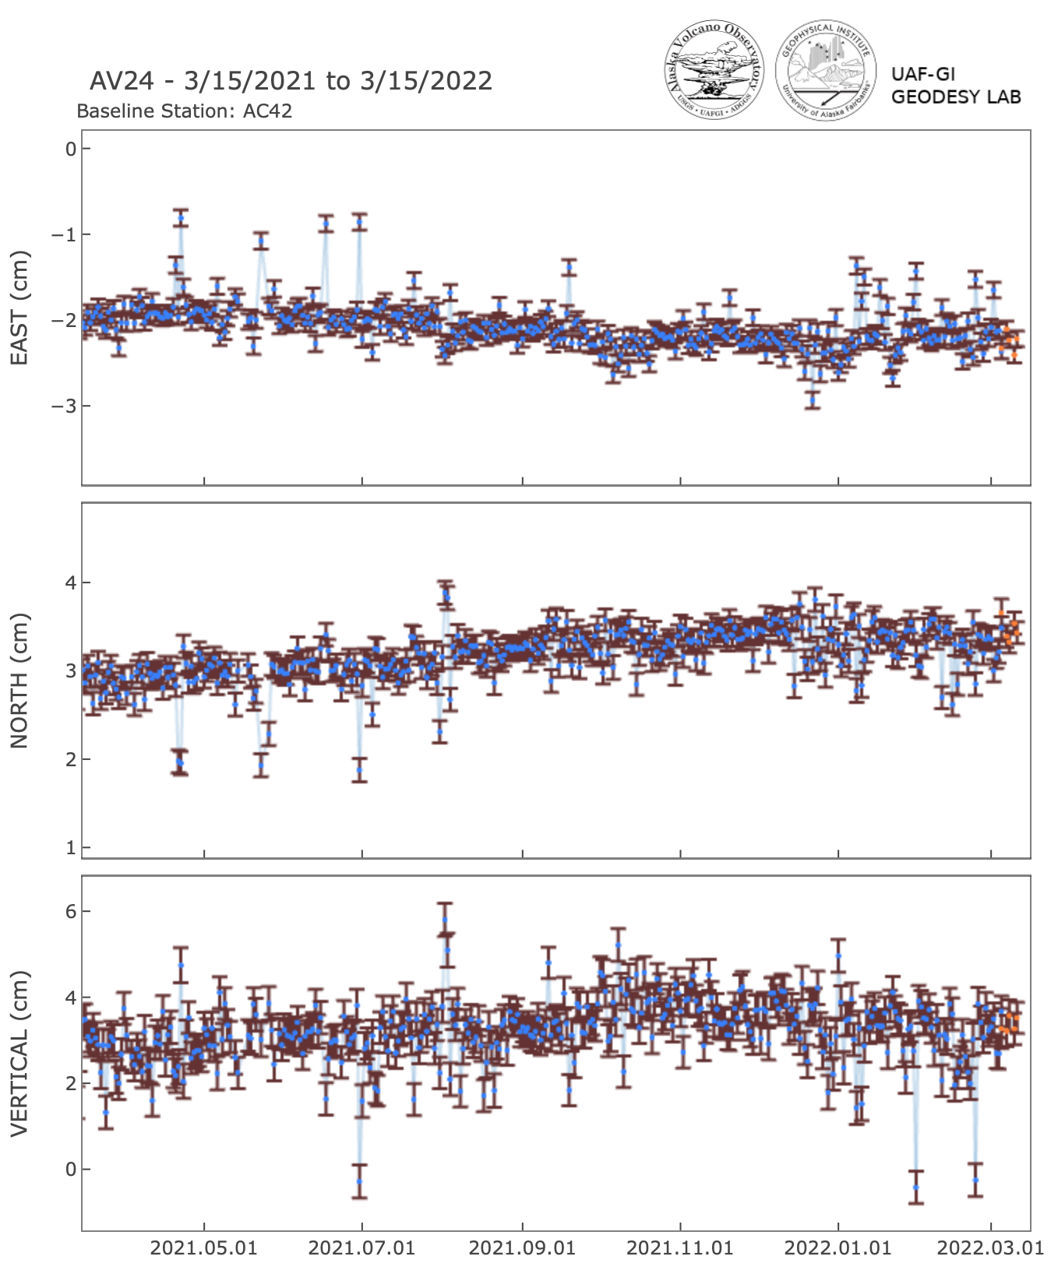
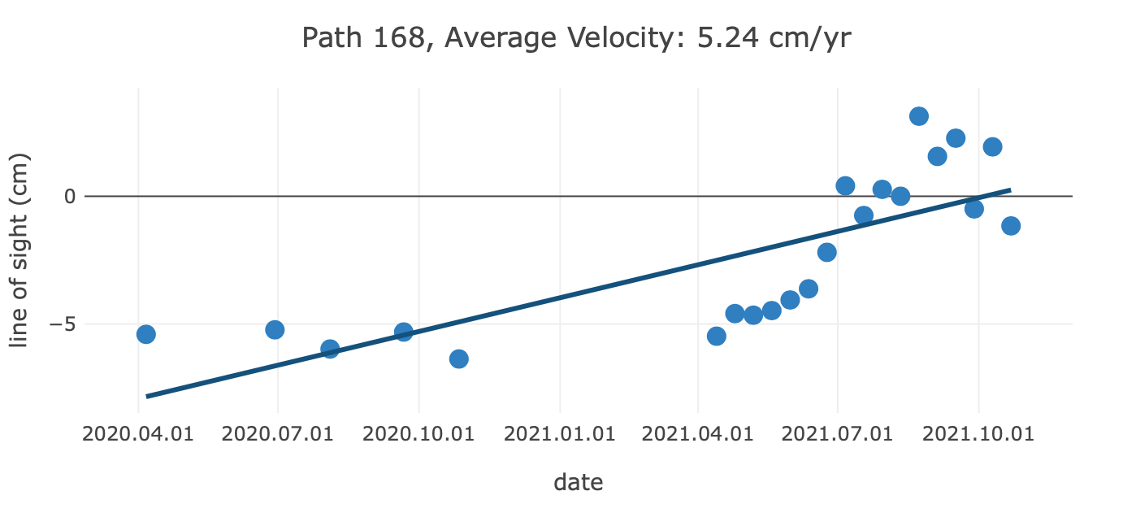
GNSS/InSAR

Slide 6
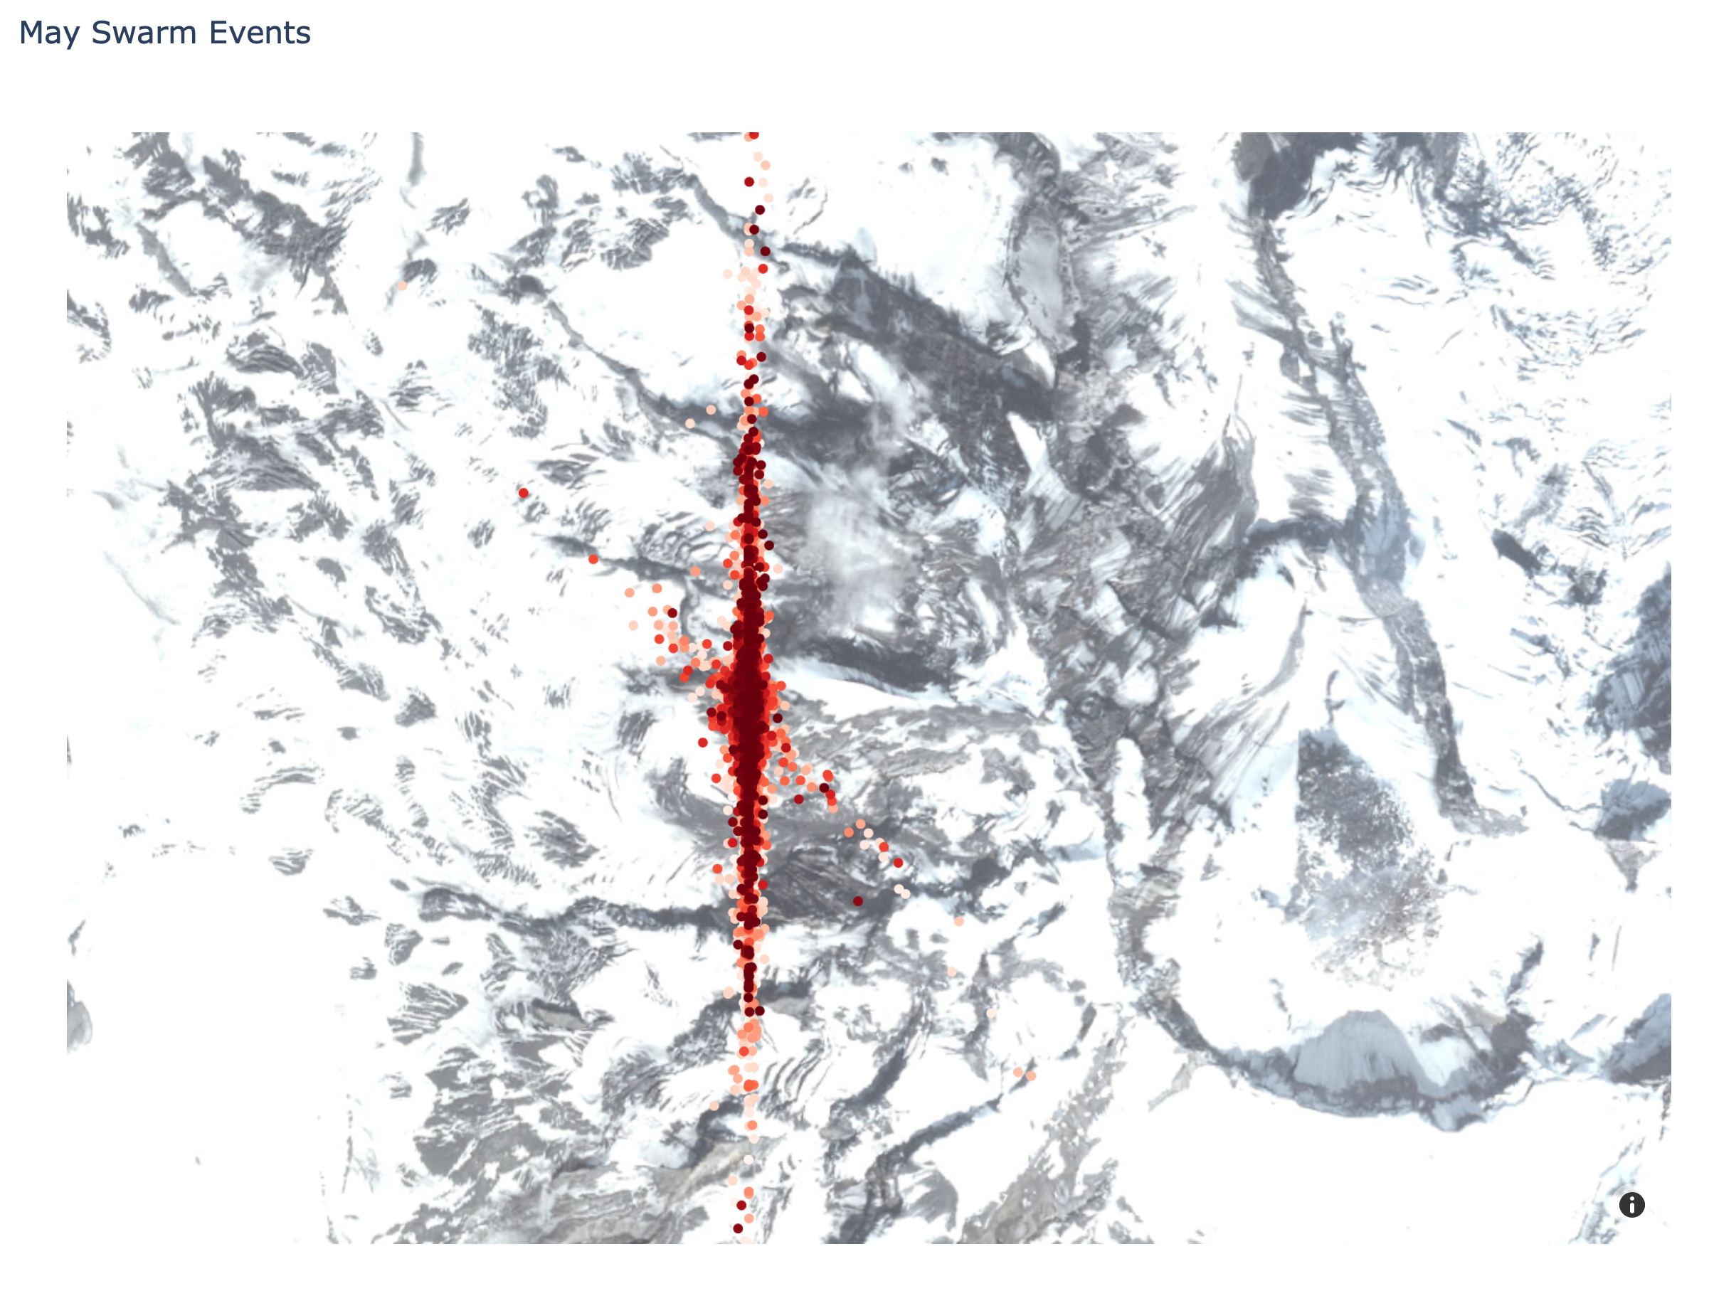
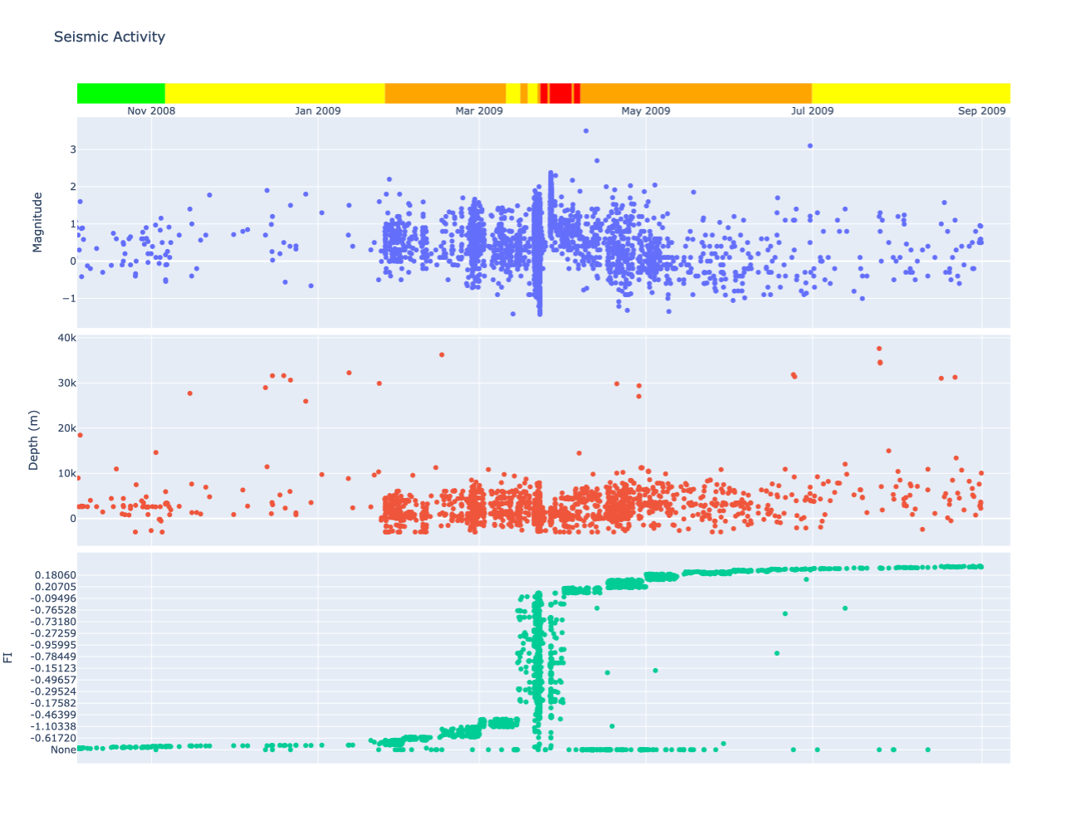
Earthquake Catalog

Slide 7
Summary
I can work with all data formats supplied, other than Excel (can be saved as CSV)
Lots of options – fully configurable
Importing XML into ObsPy is slow – not suitable for real-time interfaces
(Future) Standardize on DB

